Slide 1
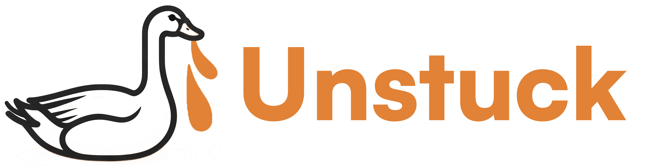
Earn Sats & Help Goose Soar!

Slide 2

The Problem
AI agents (like Goose) occasionally encounter tasks like captchas, bug fixes, code reviews, or copy edits that it cannot reliably complete or where users prefer human verification for accuracy.

Slide 3
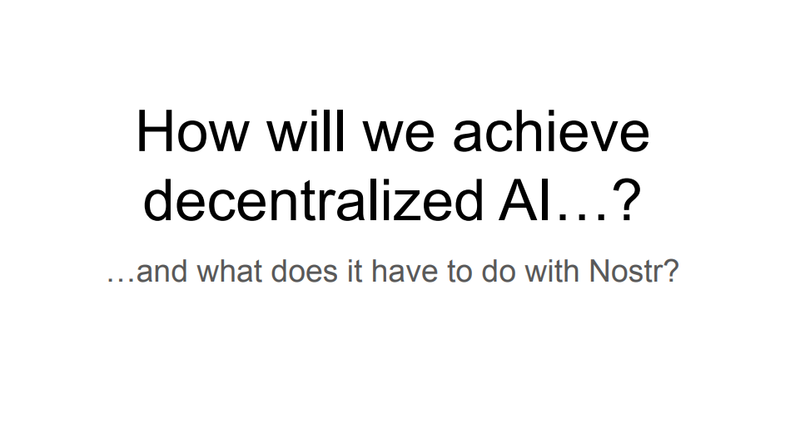

Slide 4


Slide 5
The Solution
Unstuck is a Model Context Protocol (MCP) integrated with Goose that seamlessly connects users to a GUI job board for tasks requiring human intervention, such as captchas, bug fixes, code reviews, and copy edits.
Through an intuitive GUI webpage, users can bid tasks when Goose encounters automation challenges or when they seek human verification for premium quality.

Slide 6
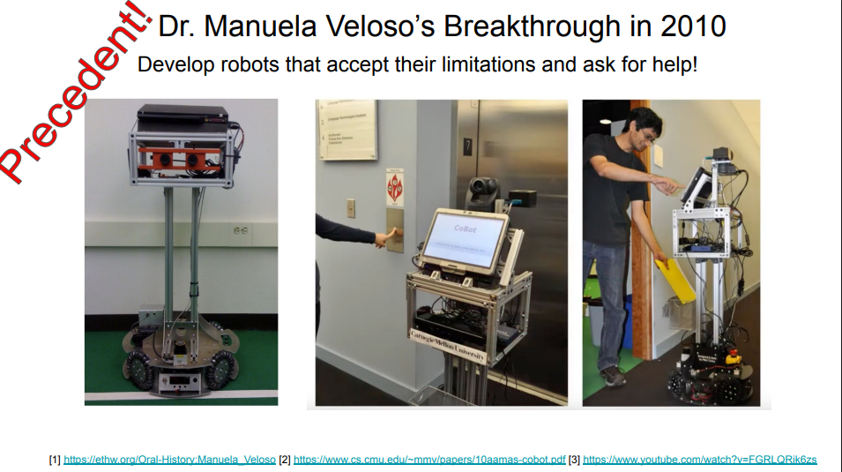

Slide 7
Demo

Slide 8
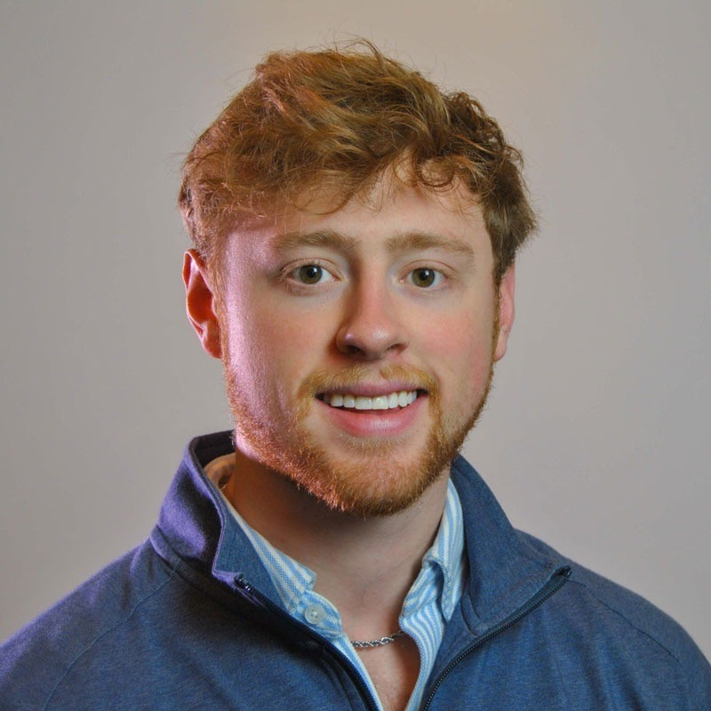

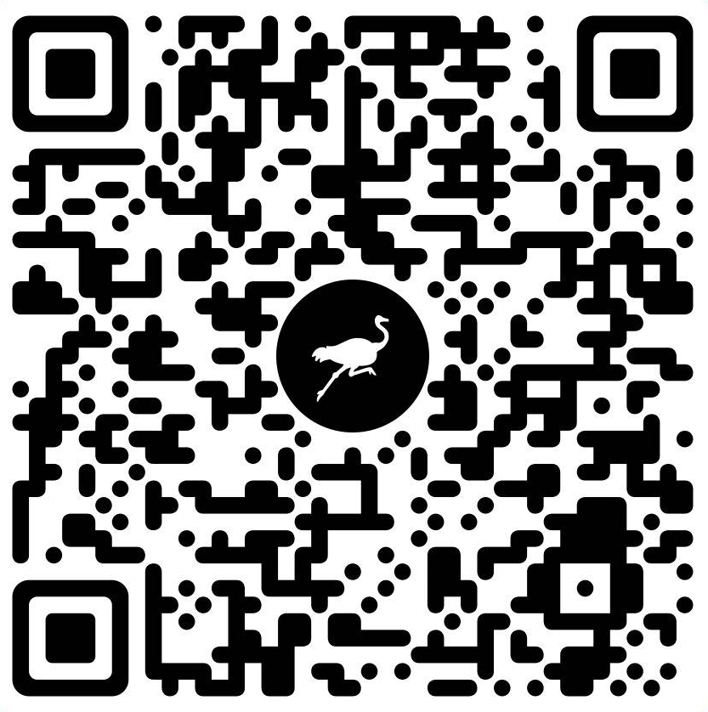
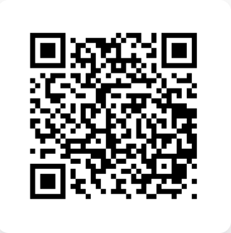
Dustin Dannenhauer
OpenSats Grantee working at the intersection of AI and Nostr
Dustin’s NPUB
Matthew Ball
Product Designer @ GE Aerospace
Creative Director @ The Bitcoin Layer
github.com/dtdannen/unstuck-ai

